Slide 1
MapReduce

Slide 2
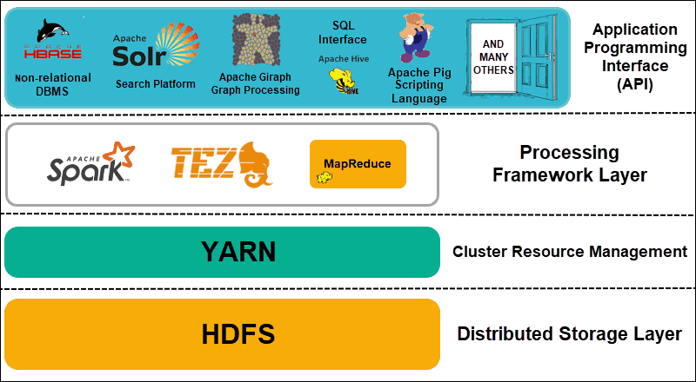
Hadoop Architecture
Distributed Storage
Hadoop Distributed File System (HDFS)
Data is split into blocks then stored in different nodes with their own resources
Master nodes keep metadata
Cluster Resource Management
Yet Another Resource Negotiator (YARN)
Coordinate nodes for data processing
Processing Framework
MapReduce, Spark
Process and analyze data
API
Various applications

Slide 3
Introduction to MapReduce
A framework for
Processing vast amounts of data (multi-terabyte data-sets)
In parallel on large clusters (thousands of nodes)
Commodity hardware
Reliable, fault-tolerant manner

Slide 4
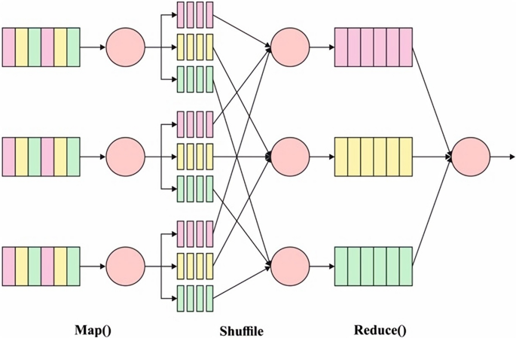
MapReduce Overall
A MapReduce process
Splits the input dataset into independent chunks
Processes input chunks with the mappers in a completely parallel manner
Sorts the outputs of the mappers
Feeds to sorted output to the reducers
Data
Map
Sort
Reduce

Slide 5
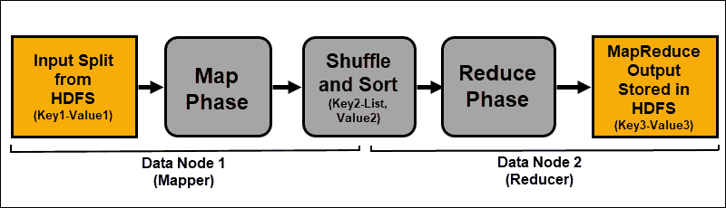
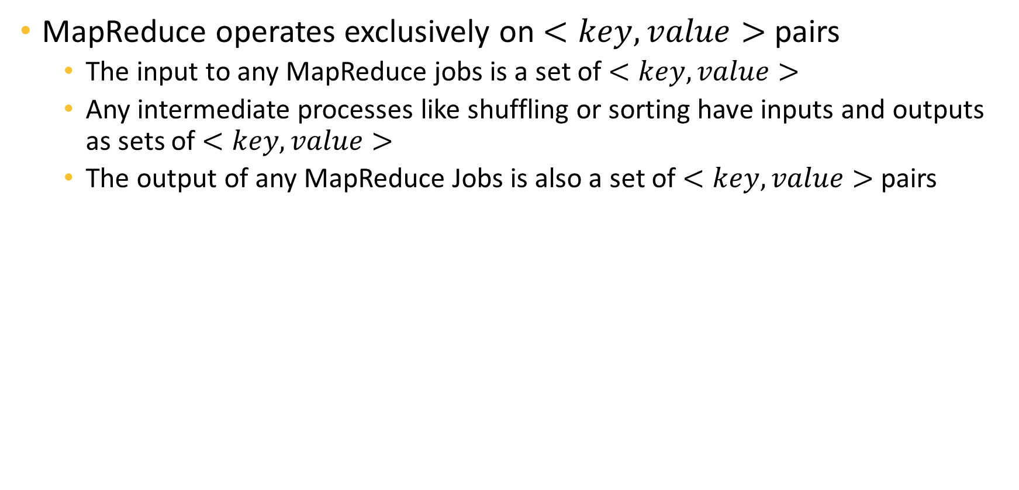
Key-Value Pairs
MapReduce operates exclusively on $<key, value>$pairs
The input to any MapReduce jobs is a set of $<key,value>$
Any intermediate processes like shuffling or sorting have inputs and outputs as sets of $<key,value>$
The output of any MapReduce Jobs is also a set of $<key,value>$ pairs

Slide 6
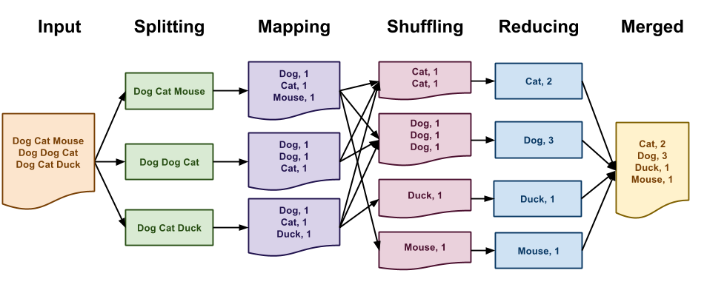
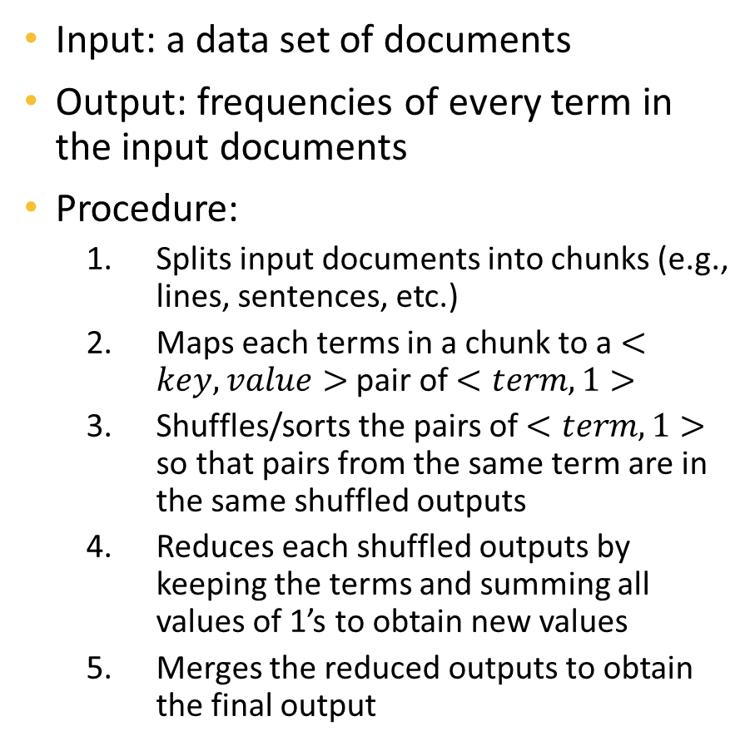
Example – Word Counting
Input: a data set of documents
Output: frequencies of every term in the input documents
Procedure:
Splits input documents into chunks (e.g., lines, sentences, etc.)
Maps each terms in a chunk to a $<key,value>$ pair of $<term,1>$
Shuffles/sorts the pairs of $<term,1>$ so that pairs from the same term are in the same shuffled outputs
Reduces each shuffled outputs by keeping the terms and summing all values of 1’s to obtain new values
Merges the reduced outputs to obtain the final output

Slide 7
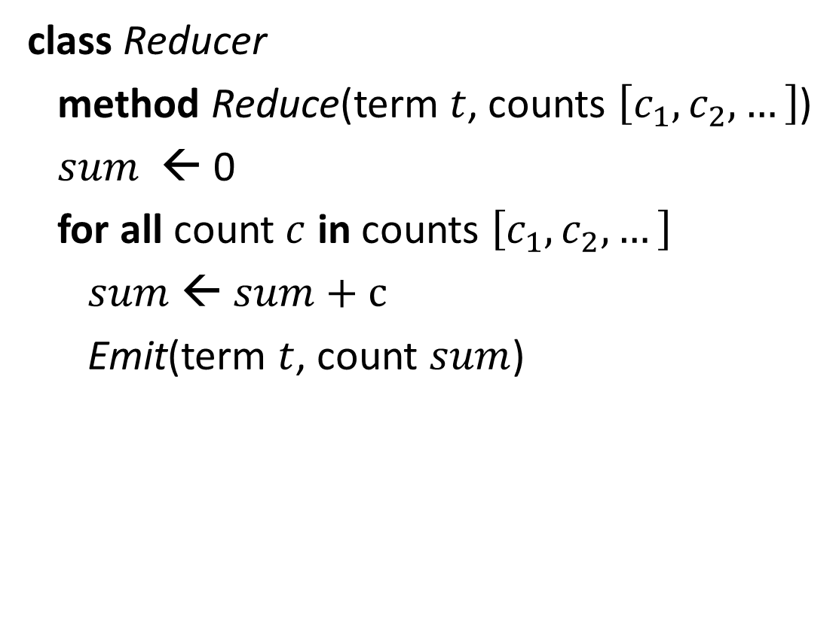
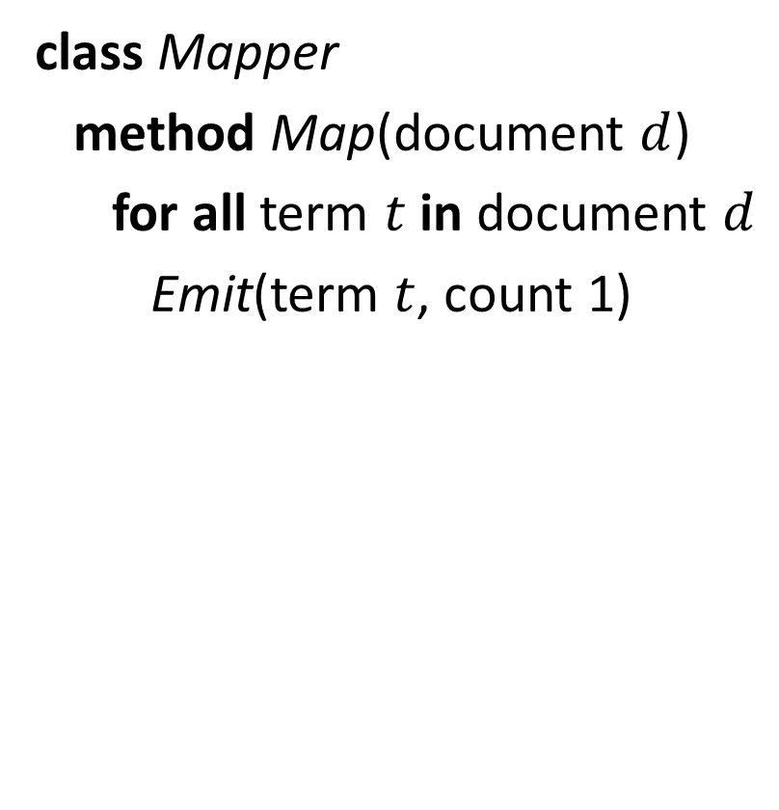
Pseudocode for Word Counting MapReduce
class Mapper
method Map(document $d$)
for all term $t$ in document $d$
Emit(term $t$, count 1)
class Reducer
method Reduce(term $t$, counts $\left[c_{1},c_{2},…\right]$)
$sum$ ← 0
for all count $c$ in counts $\left[c_{1},c_{2},…\right]$
$sum$ ← $sum+c$
Emit(term $t$, count $sum$)

Slide 8
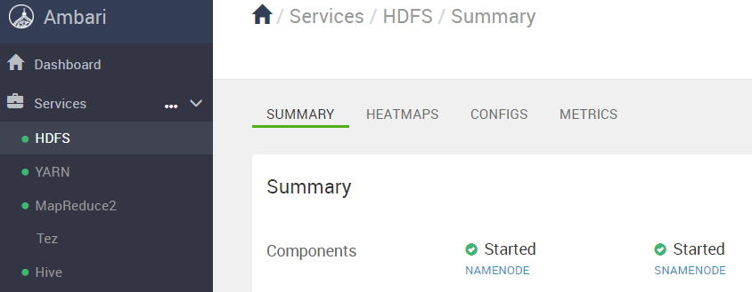
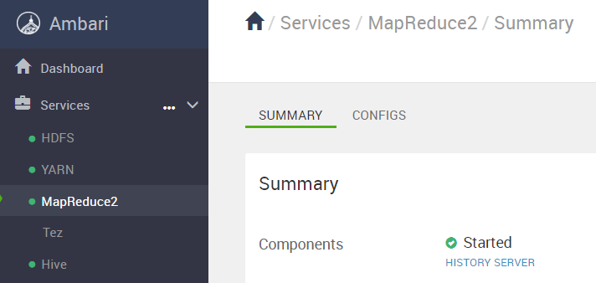
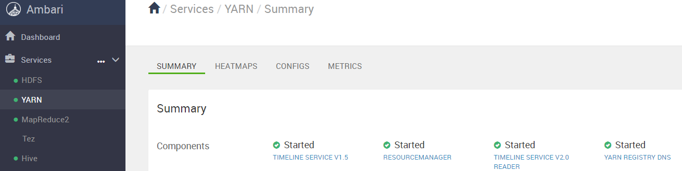
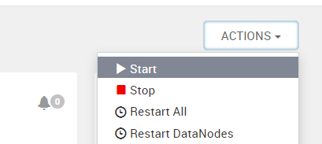
Word Count Hands-on
Cluster set up:
Make sure HDFS, YARN, and MapReduce have started
Select ACTIONS → Start if the service is not running
In HDFS View
Go to tmp folder
Create a folder wordcount
Create a folder input
Upload file01 and file02 to the input folder

Slide 9
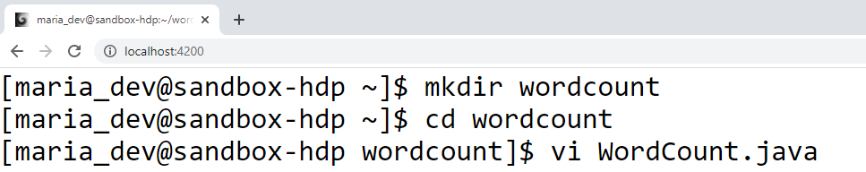
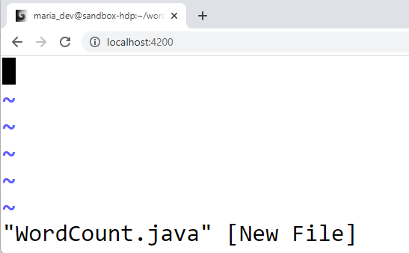
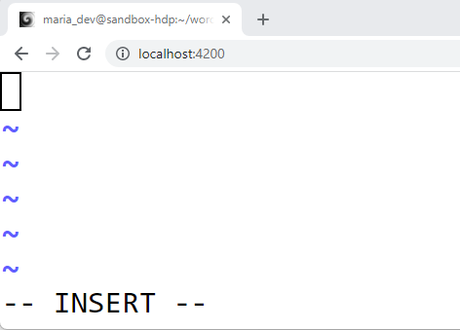
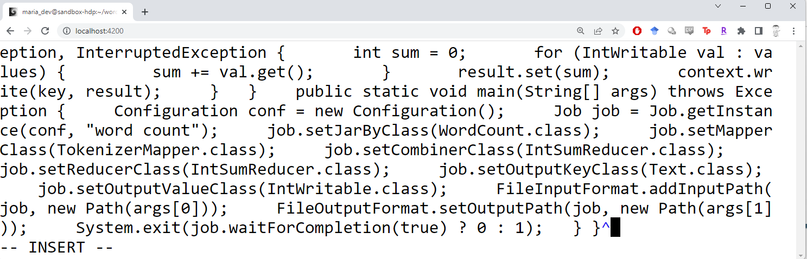
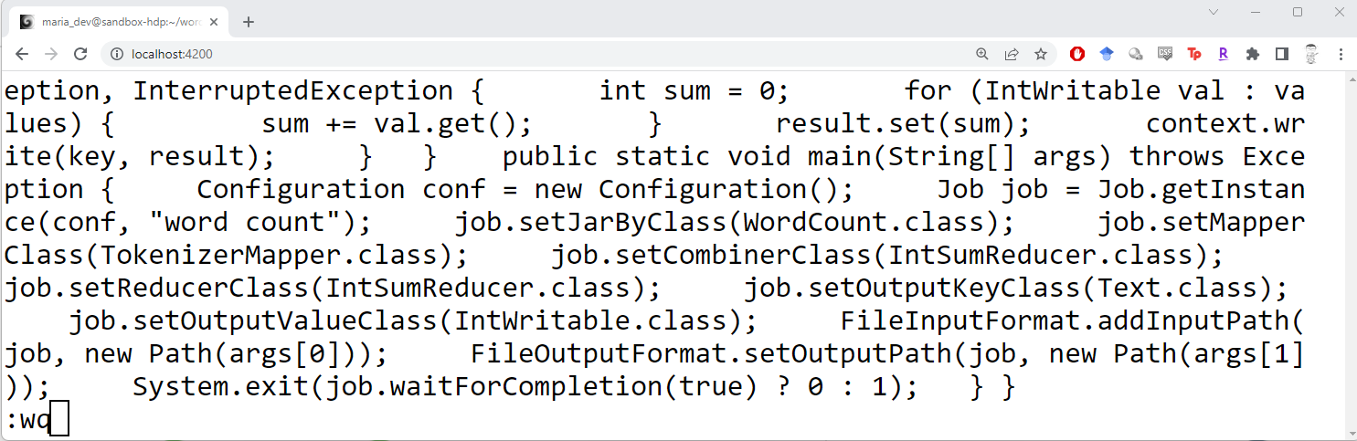
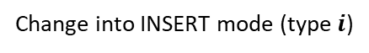
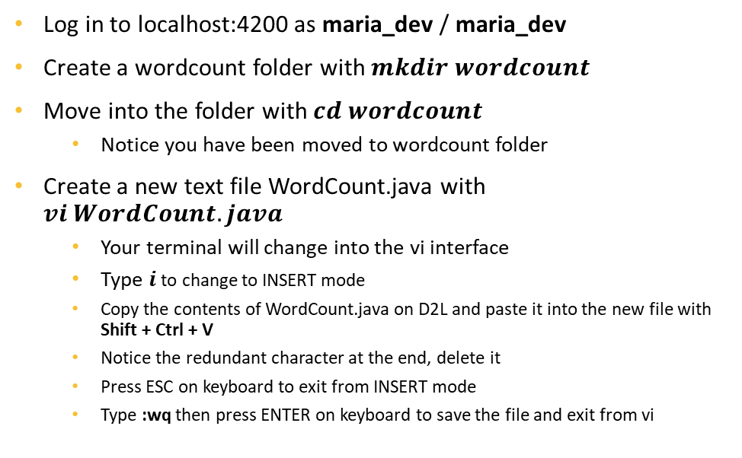
Transfer the MapReduce Code to the Cluster
Log in to localhost:4200 as maria_dev / maria_dev
Create a wordcount folder with $mkdir wordcount$
Move into the folder with $cd wordcount$
Notice you have been moved to wordcount folder
Create a new text file WordCount.java with $vi WordCount.java$
Your terminal will change into the vi interface
Type $i$ to change to INSERT mode
Copy the contents of WordCount.java on D2L and paste it into the new file with Shift + Ctrl + V
Notice the redundant character at the end, delete it
Press ESC on keyboard to exit from INSERT mode
Type :wq then press ENTER on keyboard to save the file and exit from vi
Change into Vi interface
Change into INSERT mode (type $i$)
Paste content of D2L file
ESC then :wq then ENTER

Slide 10
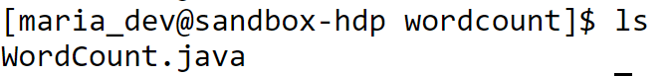
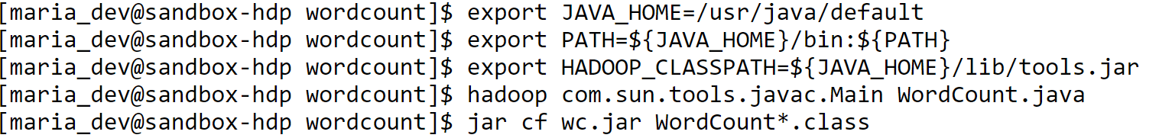
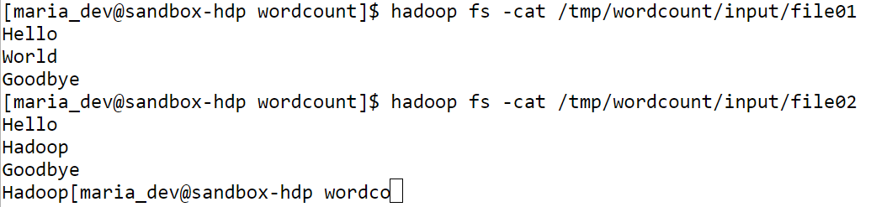
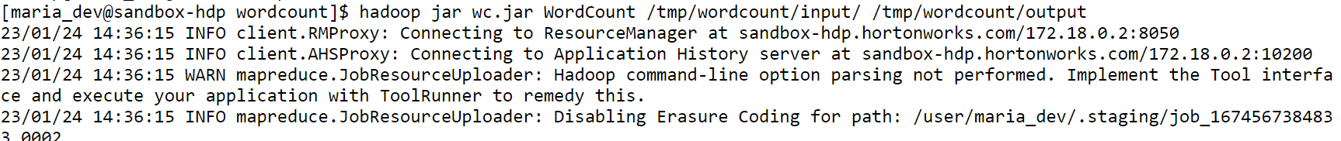
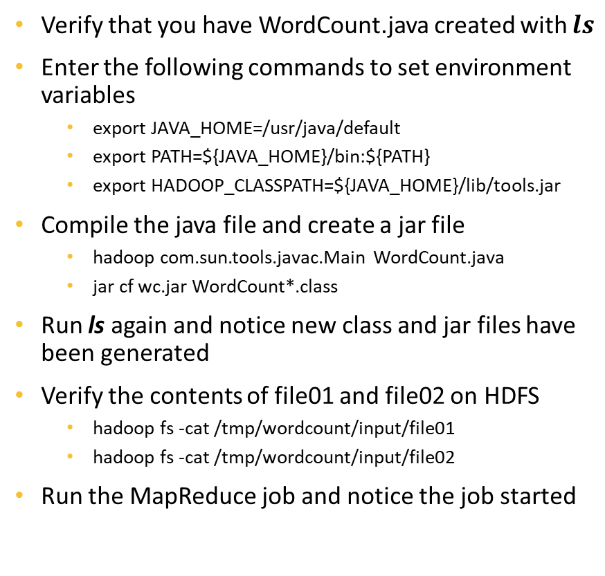
Run the MapReduce Job
Verify that you have WordCount.java created with $ls$
Enter the following commands to set environment variables
export JAVA_HOME=/usr/java/default
export PATH=${JAVA_HOME}/bin:${PATH}
export HADOOP_CLASSPATH=${JAVA_HOME}/lib/tools.jar
Compile the java file and create a jar file
hadoop com.sun.tools.javac.Main WordCount.java
jar cf wc.jar WordCount*.class
Run ls again and notice new class and jar files have been generated
Verify the contents of file01 and file02 on HDFS
hadoop fs -cat /tmp/wordcount/input/file01
hadoop fs -cat /tmp/wordcount/input/file02
Run the MapReduce job and notice the job started
hadoop jar wc.jar WordCount /tmp/wordcount/input/ /tmp/wordcount/output

Slide 11
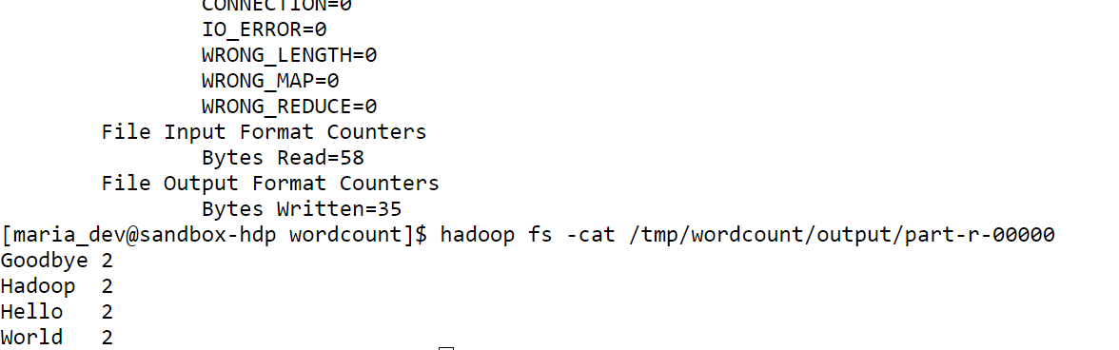
Word Count MapReduce Results
There will be a lot of outputs in the terminal and the process will take a few minutes
When the job finishes, check the result with
hadoop fs -cat /tmp/wordcount/output/part-r-00000
Each term in the two files and its frequency will be showed

Slide 12
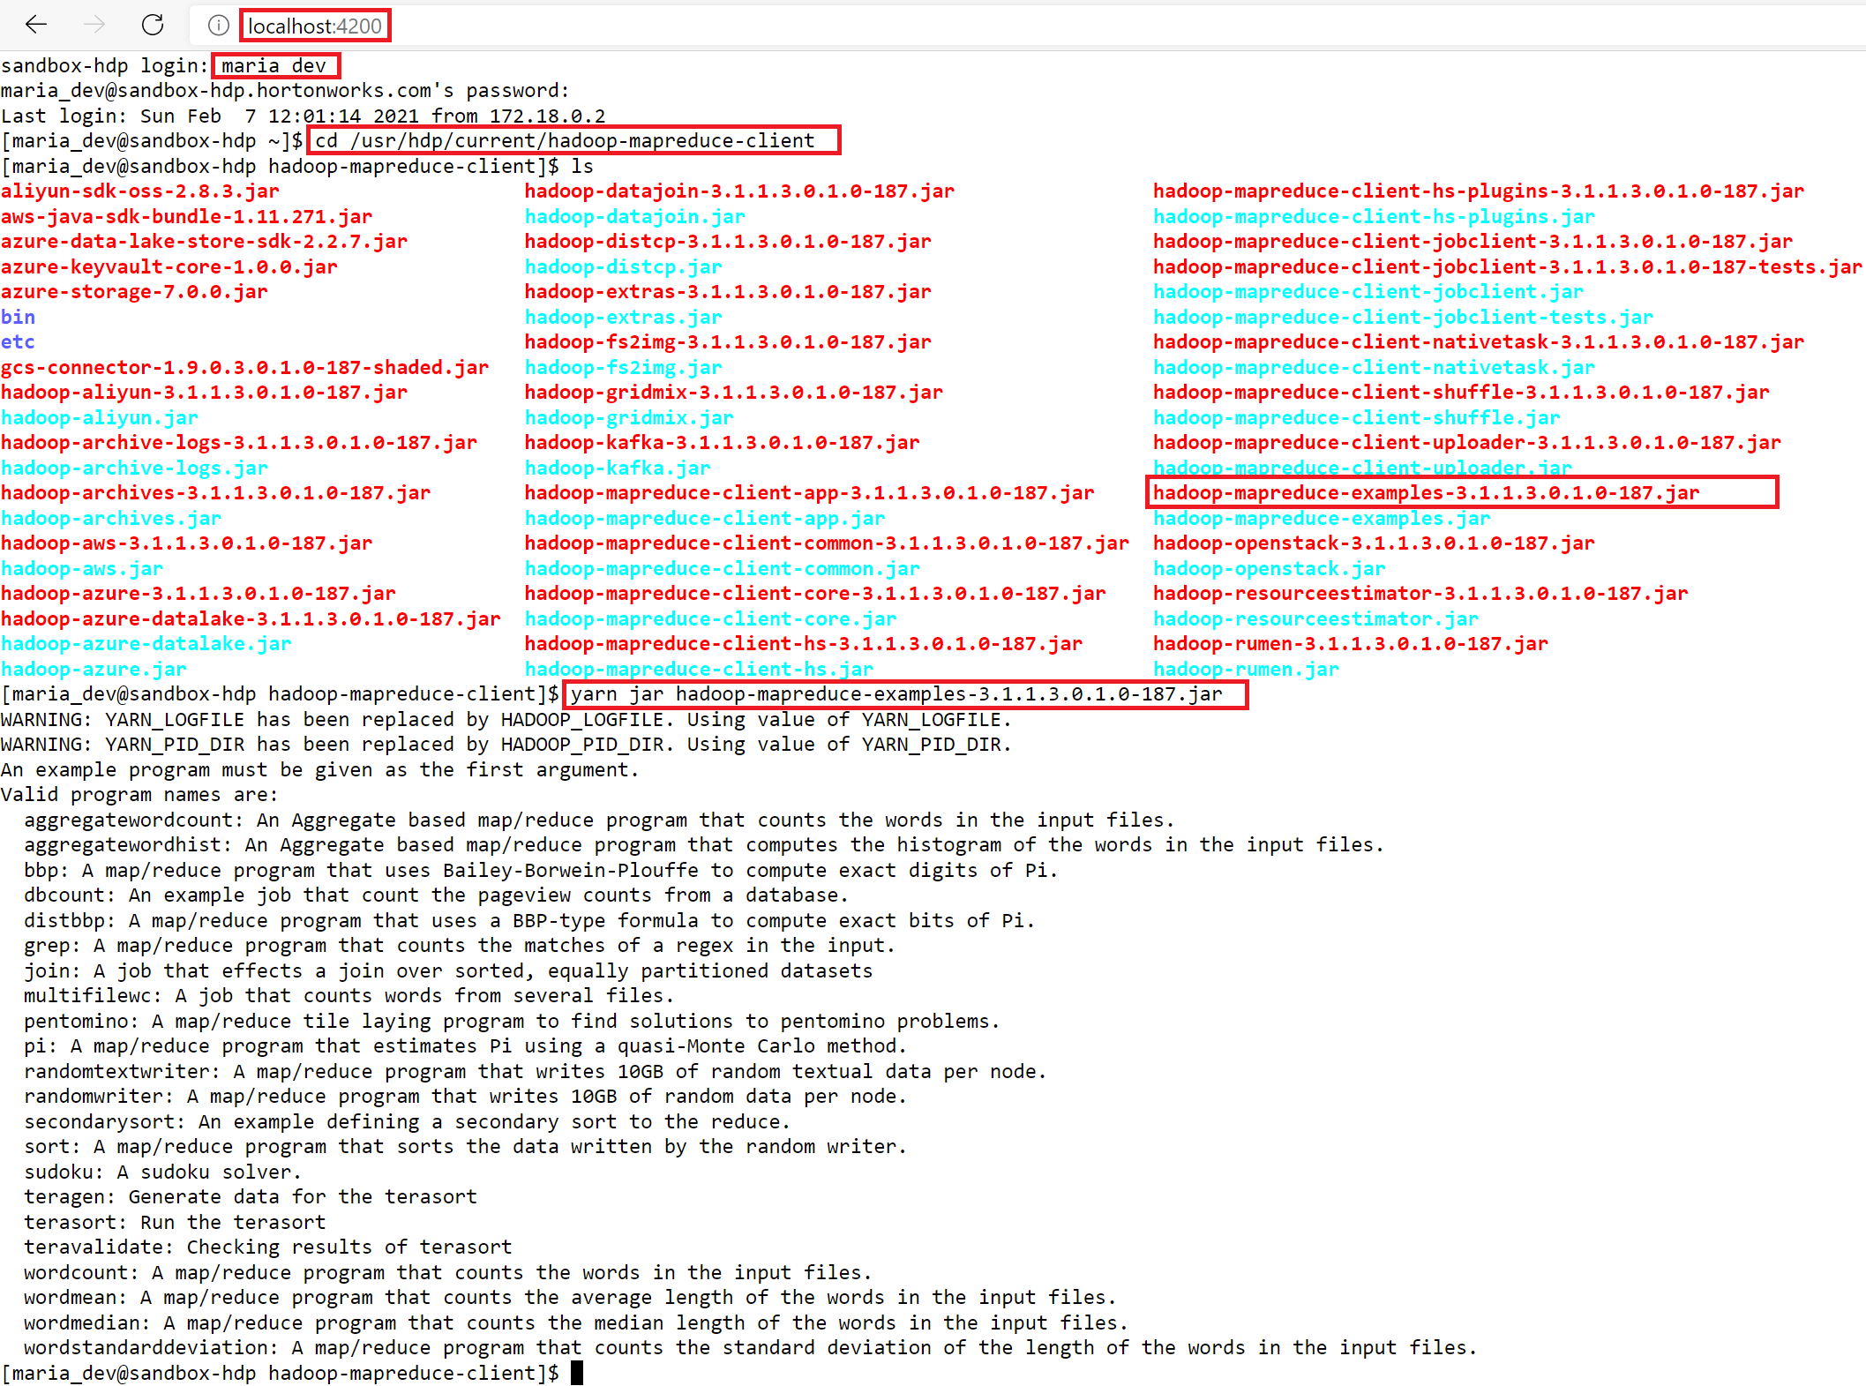
Other MapReduce Examples
In the SSH shell:
cd /usr/hdp/current/hadoop-mapreduce-client
ls

Slide 13
Run the Estimation of Pi Example
In the /usr/hdp/current/hadoop-mapreduce-client folder, execute
yarn jar hadoop-mapreduce-examples-3.1.1.3.0.1.0-187.jar pi 16 100000

Slide 14
Monitor MapReduce Running Jobs
In your browser, go to 127.0.0.1:8088

Slide 15
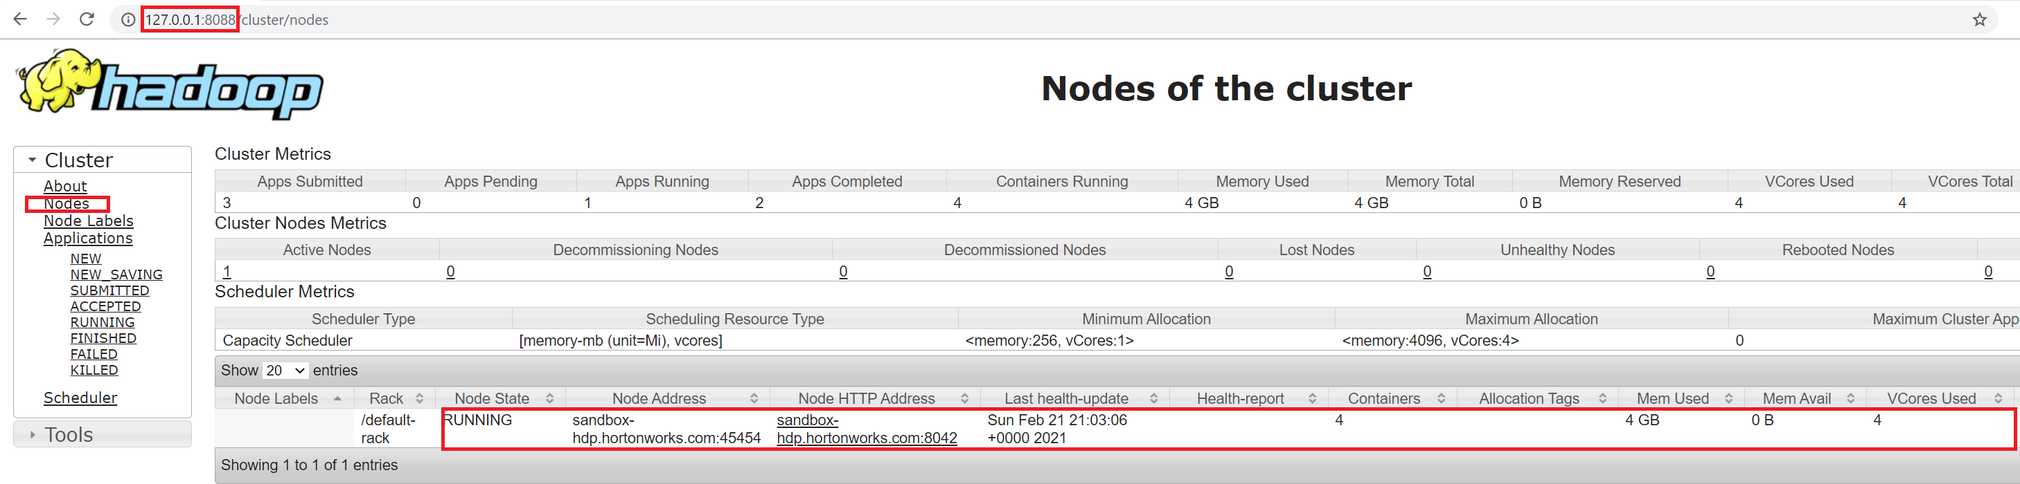
Monitor Notes of Cluster

Slide 16
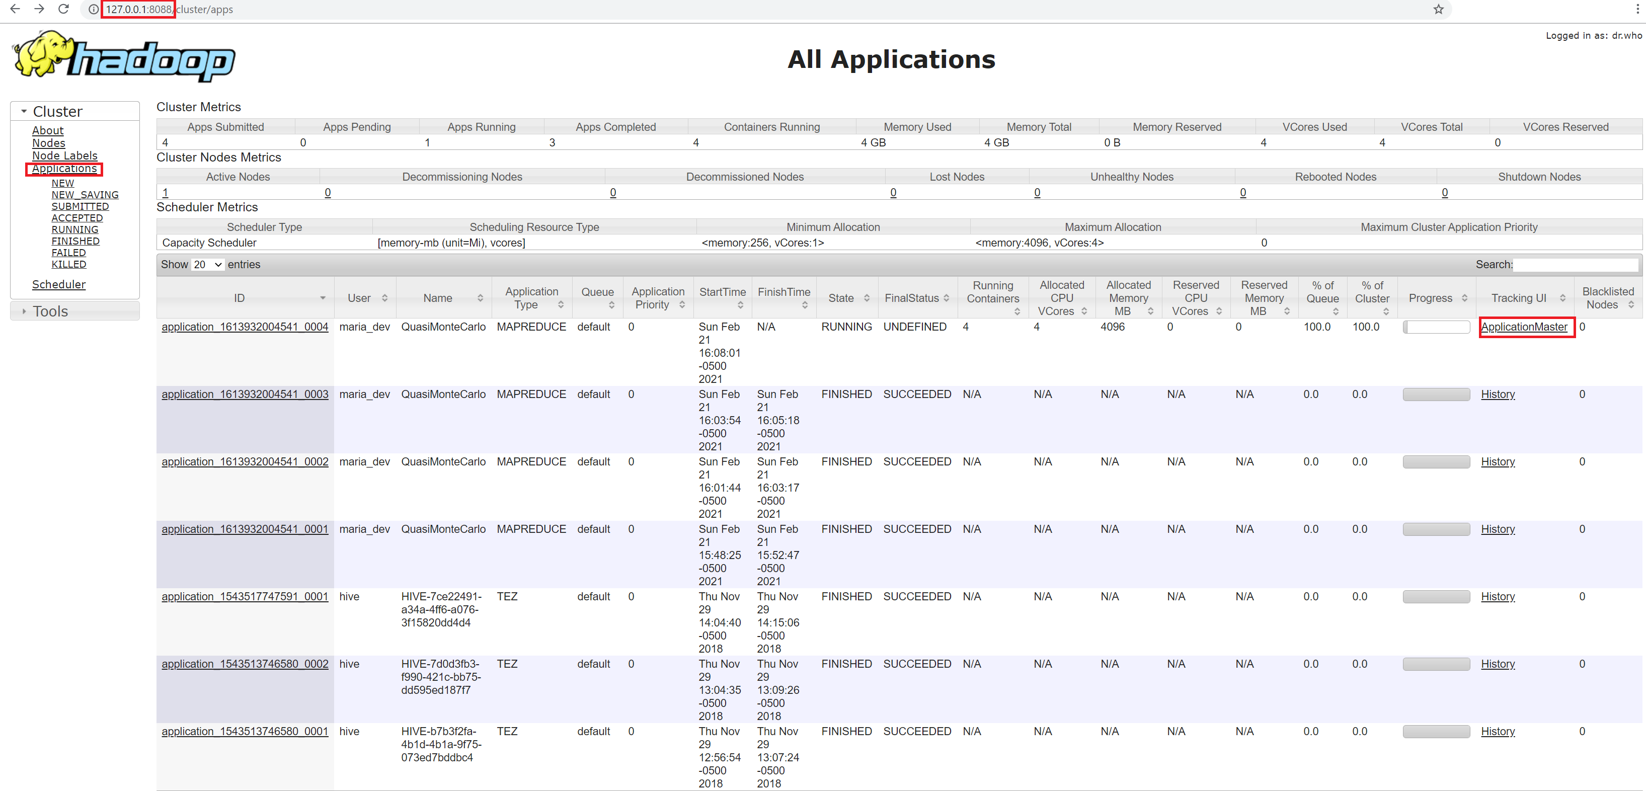
Monitor A Particular Job

Slide 17
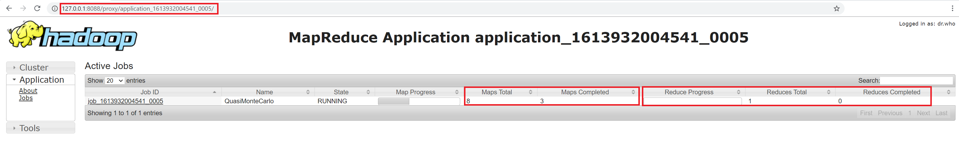
MapReduce Job Details
The url linked by ApplicationMaster is not correct
Simply edit sandbox-hdp.hortonworks.com to 127.0.0.1 in the address bar of your browser
Do not change anything in the proxy/application_id

Slide 18
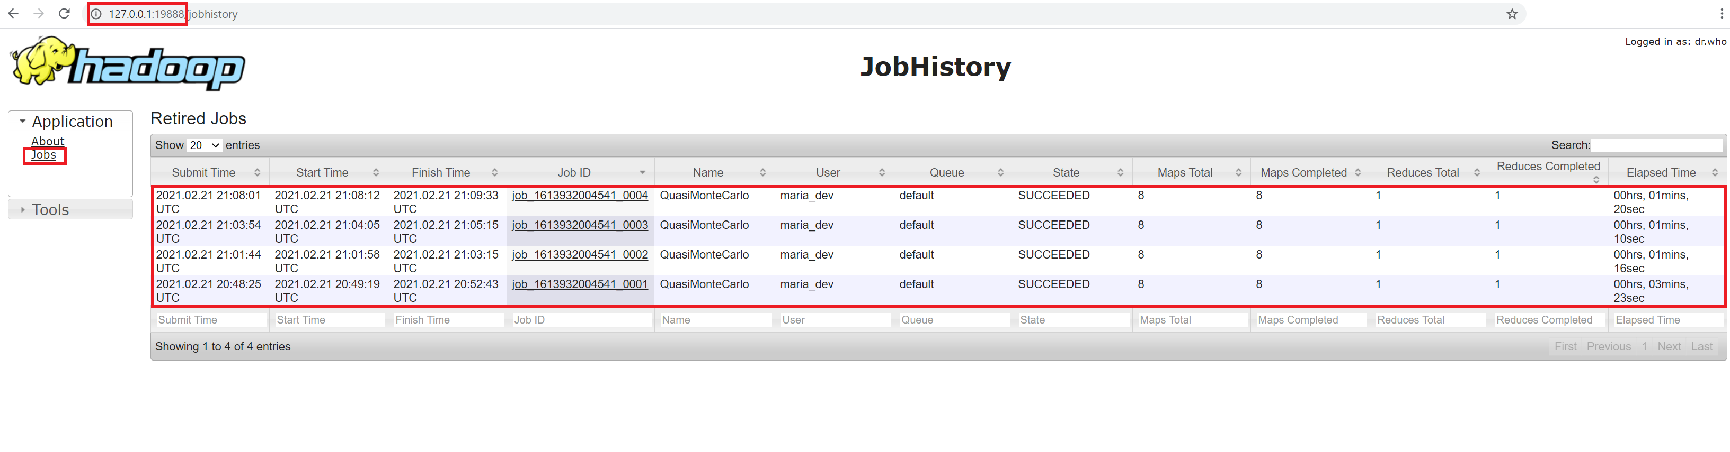
Job History
In your browser, go to 127.0.0.1:19888

Slide 19
Another MapReduce Example - terasort
Create a folder “terasort” in the home directory on HDFS

Slide 20
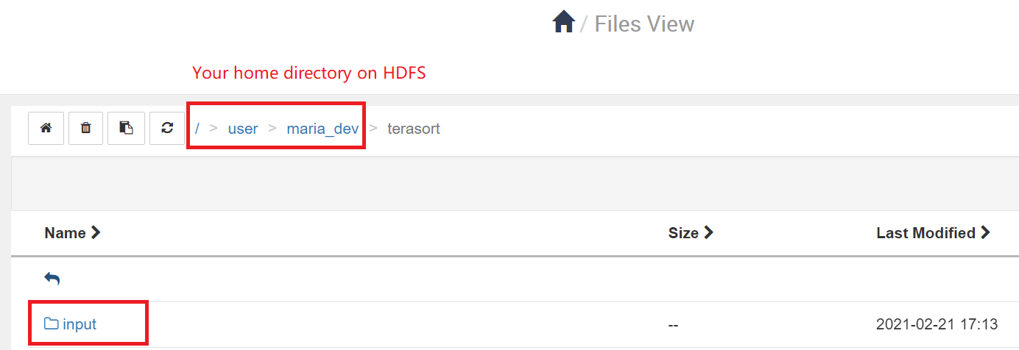
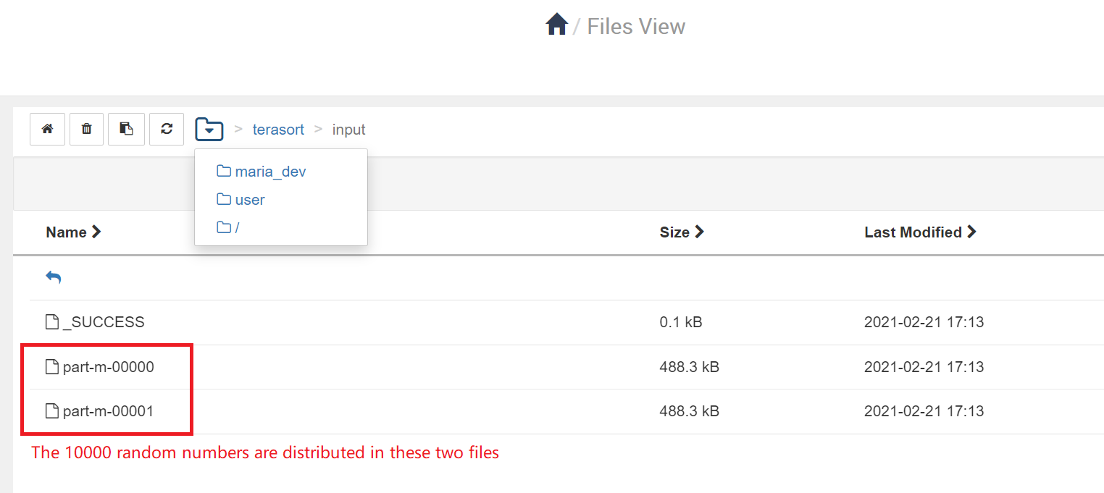
Generate Input Data
In SSH, execute
yarn jar hadoop-mapreduce-examples-3.1.1.3.0.1.0-187.jar teragen 10000 terasort/input
This generates 10000 random binary numbers for sorting
The generated random numbers will be put under terasort/input directory

Slide 21
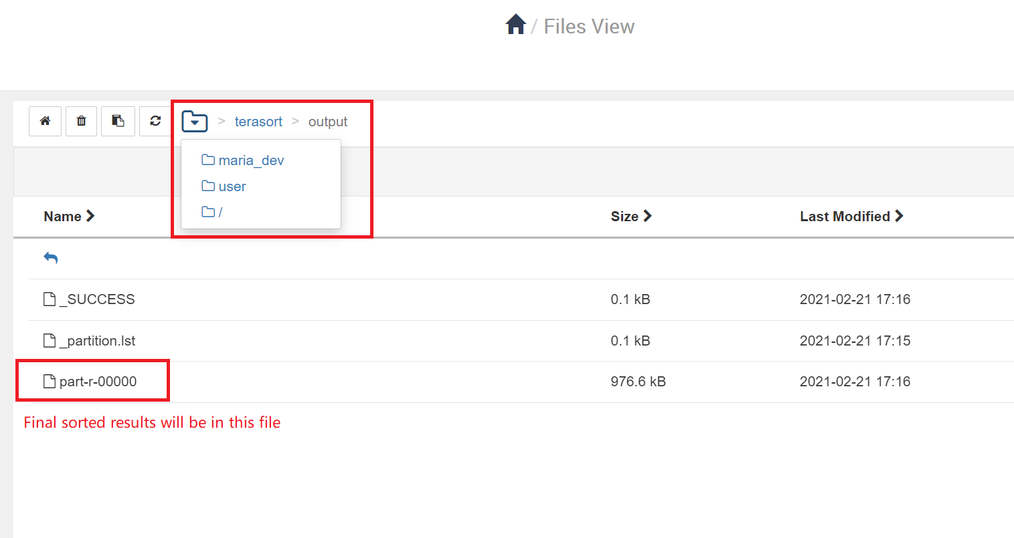
Execute the Job
yarn jar hadoop-mapreduce-examples-3.1.1.3.0.1.0-187.jar teragen terasort terasort/input terasort/output
The result will be put in output folder terasort/output
The output directory must not exist before you execute this command
A new directory output will be automatically created under terasort to store the sorted results

Slide 22
Some Important URLs for VirtualBox
127.0.0.1:8080 - Hadoop Server Dashboard
127.0.0.1:4200 – SSH to Hadoop Server
127.0.0.1:8088 – Monitor Jobs and Cluster Status
127.0.0.1:19888 – MapReduce Job History UI
127.0.0.1:19888/logs – MapReduce Job History logs

Slide 23
Extra Reading
https://hadoop.apache.org/docs/r3.3.4/hadoop-mapreduce-client/hadoop-mapreduce-client-core/MapReduceTutorial.html

